Slide 1

L AN DEFAULT PREDICTION & EXPLAINABLE AI
PRESENTED BY:
SREERAG M C

Slide 2
PRESENTATION OUTLINE
Introduction
Data Overview
EDA
Data Preparation
Data Split
Model Training: XGBoost
Model Training: Random Forest
Explainable AI: Introduction
Deepchecks
SHAP value
Anchors
Counterfactuals

Slide 3
INTRODUCTION
Financial Institutions often involve human experts in decision making. XAI facilitates collaboration b/w humans and AI.
In this exciting project, we’re diving deep into the heart of this challenge. We’ll use XGBoost and RandomForest as our trusty guides.
The XAI toolkit enables us to unravel the intricate threads of AI decision making, bringing clarity to our prediction process.

Slide 4
DATA PREPERATION
Drop categorical columns
Multi-collinearity
Feature Encoding
Handling Missing Values
Skewness
Fix data imbalance

Slide 5
HANDLING MISSING VALUES
df.isnull().sum()
User_id 0
Loan Category 0
Amount 31924
Interest Rate 0
Tenure(years) 0
User id_x 0
Employmet type 84641
Tier of Employment 84642
Industry 4
Role 0
Work Experience 4
Total Income(PA) 0
User id_y 0
Gender 0
Married 48143
Dependents 0
Home 0
Pincode 0
Social Profile 47856
Is_verified 35803
Delinq_2yrs 0
Total Payement 0
Received Principal 0
Interest Received 0
Number of loans 0
Defaulter 0

Slide 6
HANDLING MISSING VALUES
Social profile: Create a new category for NA values.
Is verified: Create a new category for NA values.
Married: Create a new category for NA values.
Industry: Consider dropping missing values.
Work experience: Consider dropping missing values.
Amount: Evaluate the impact of removing rows with missing values on the data distribution.
Employment type: Determine the appropriate approach for handling missing values.
Tier of employment: Determine the appropriate approach for handling missing values.

Slide 7
DROP CATEGORICAL COLUMNS WITH TOO MANY CATEGORIES
User_id : 133748
Loan Category : 7
Amount : 86157
Interest Rate : 137
Tenure(years) : 2
User id_x : 133748
Employmet type : 3
Tier of Employment : 8
Industry : 12974
Role : 46
Work Experience : 7
Total Income(PA) : 11380
User id_y : 133748
Gender : 3
Married : 3
Dependents : 5
Home : 5
Pincode : 844
Social Profile : 3
Is_verified : 4
Delinq_2yrs : 22
Total Payement : 104199
Received Principal : 42021
Interest Received : 93859
Number of loans : 5
Defaulter : 2
amount_missing : 2

Slide 8
- Address the challenge of categorical columns with a large number of categories. Determine which categories fall into this category and develop a strategy for handling them.
- Some columns are ordinal and those categorical variables would need to be treated differently during categorical encoding.

Slide 9
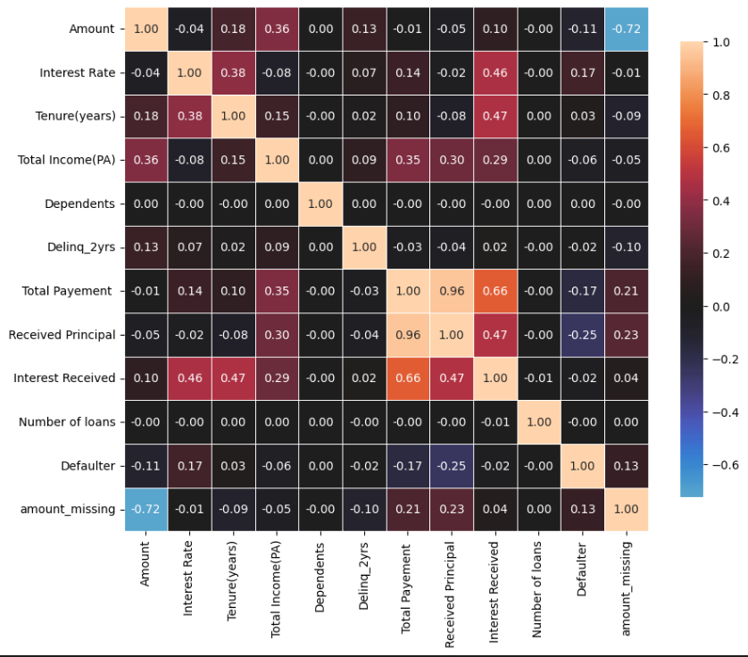
MULTICOLLINEARITY
We can notice collinearity for some features. We will address them with L1 and L2 regularization in the model.
It's safe to use all variables in machine learning model building.

Slide 10
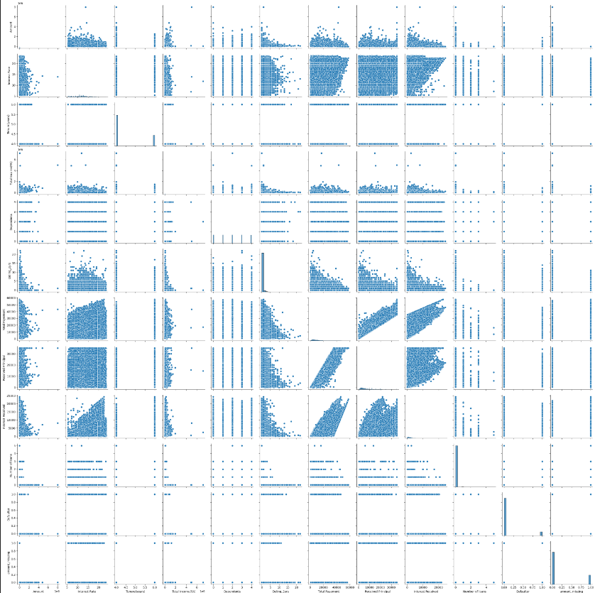
MULTICOLLINEARITY
- Scatterplots can help us confirm multicollinearity between two variables. We can look at the scatterplot to check if there is any pattern or correlation between two variables.
- Multicollinearity makes explainability less trustworthy as change in one variablte will not only impact the target variable but also impact other X variables.

Slide 11
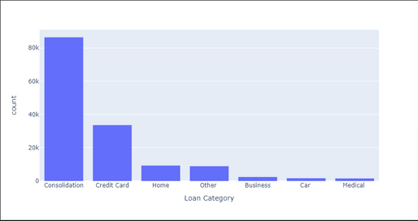
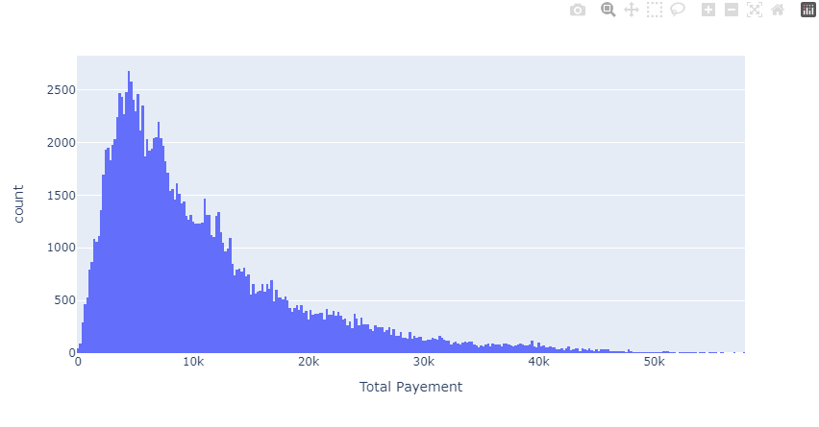
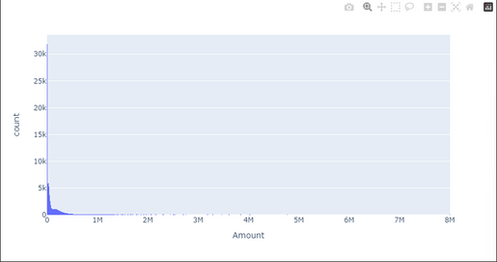
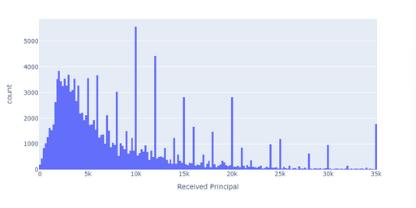
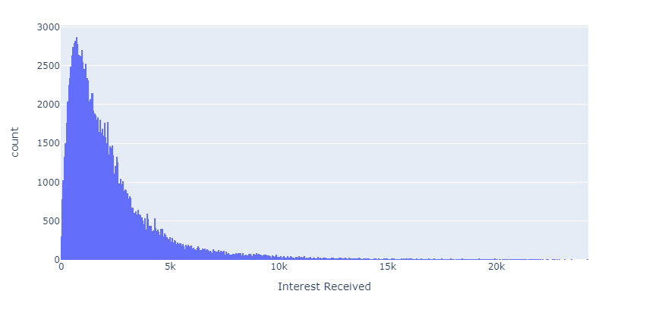
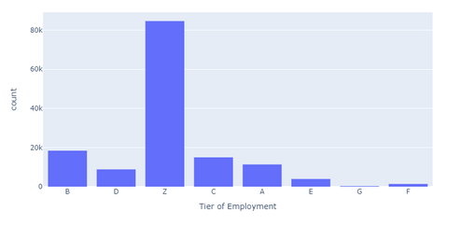
SKEWNESS
Received Principal: The distribution is right-skewed, indicating that most individuals have received a lower principal amount, while a few have received a higher amount.
Total Payment: The distribution is right-skewed, indicating that most individuals paid a lower total amount, while few instances are higher.

Slide 12
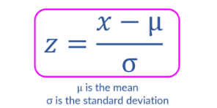
FIXING SKEWNESS
To address the presence of outliers in skewed data, we'll first correct the skewness.
One approach to mitigating the impact of outliers is by utilizing the z-score. The z-score measures how many standard deviations an individual data point is away from the mean.
Threshold:
Skewness < -3 OR Skewness > 3

Slide 13
FEATURE ENCODING
Categorical variables refer to variables that represent discrete categories or labels,
Eg. gender (male/female), marital status (single/married/divorced), or product types (A/B/C).
These variables do not have a specific numerical order or hierarchy.
CATEGORICAL VARIABLE
One Hot Encoding
Ordinal variables also represent discrete categories, but they have an inherent order or ranking associated with them.
Eg. education level (elementary/middle/high school/college), employment status (unemployed/part-time/full-time), or customer satisfaction rating (low/medium/high).
ORDINAL VARIABLE
Ordinal Encoding

Slide 14
TARGET VARIABLE IMBALANCE
SMOTE (Synthetic Minority Over-sampling Technique)
For each instance in the minority class, SMOTE selects one or more of its k nearest neighbors from the same class. The value of k is a user-defined parameter.
Synthetic samples are created by randomly selecting one or more of the nearest neighbors and by taking a weighted average of the feature values of the neighbors.
The synthetic samples are added to the dataset, effectively increasing the representation of the minority class. This process is repeated until the desired balance between the classes is achieved.

Slide 15
XGBOOST

Slide 16
MODEL TRAINING: XGBOOST
01
02
03
DATA SPLIT
HYPEROPT
MODEL VALIDATION
The Data Split here is 80:20 split.
Training data- 80%
Testing data- 20%
Hyperparameter Tuning for the model to run with the best parameters to ensure a better overall prediction power.
The classification report of the performance of our XGBoost model.

Slide 17
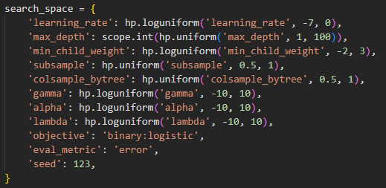
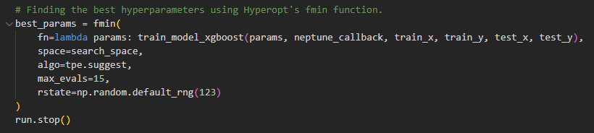
01
02
03
HYPEROPT
HyperOPT is a python library for hyperparameter tuning. Unlike Grid Search or Random search, HyperOPT uses optimized techniques to effectively search the hyperparameter space.
Uses Bayesian Optimization for hyperparameter tuning
Allows users to define search space of hyperparameter using distributions such as uniform, log-uniform, normal and discrete distributions.
Sequential Model-Based Optimization (SMBO)
Tree-structured Parzen Estimator (TPE)

Slide 18
01
02
03
MODEL VALIDATION
Classification Report:
precision recall f1-score support
0 0.76 0.83 0.79 25937
1 0.81 0.75 0.78 26165
accuracy 0.79 52102
macro avg 0.79 0.79 0.79 52102
weighted avg 0.79 0.79 0.79 52102
Confusion Matrix: [[21453 4484 ]
[ 6630 19535]]

Slide 19
RANDOM FOREST

Slide 20
MODEL TRAINING: RANDOMFOREST
01
02
03
DATA SPLIT
GRIDSEARCHCV
MODEL VALIDATION
The Data Split here is 80:20 split.
Training data- 80%
Testing data- 20%
RandomForest uses a simpler GridsearchCV approach to find the best parameters to train the model.
The classification report of the performance of our RandomForest model.

Slide 21
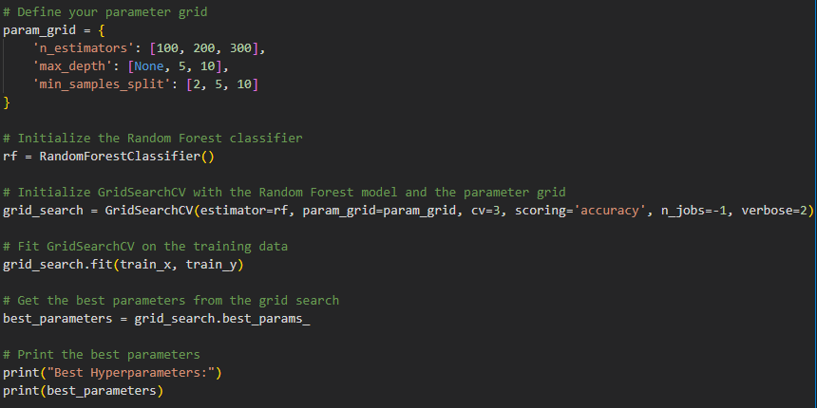
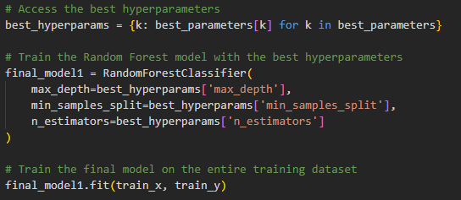
01
02
03
GRIDSEARCHCV
Gridsearch goes through the list of parameters to choose the best combination that provides the best scoring (accuracy).
While the gridsearch is a more simple and primitive method, it works well for a RandomForest model.

Slide 22
01
02
03
MODEL VALIDATION
precision recall f1-score support
0 1.00 0.99 1.00 25937
1 0.99 1.00 1.00 26165
accuracy 1.00 52102
macro avg 1.00 1.00 1.00 52102
weighted avg 1.00 1.00 1.00 52102
Confusion Matrix:
[[25773 164]
[ 0 26165]]

Slide 23
RESULT
For our Default Prediction model lets focus more on the XGBoost model as the advance features of XGBoost provides us the confidence that the model is not overfitting with out data.
Model False Prediction:
FP : 4484 i.e we incorrectly predicted someone to be a defaulter while they were not.
FN : 6630 i.e we incorrectly predicted someone to not be a defaulter (expensive) while they were defaulters.

Slide 24
IMPACT
COST of FP: $ 10000
Let's assume that the average amount of loan given to the customer is more than 10,000 and a lending institution will lose 10,000 on average if someone doesn’t default. This is the cost associated with incorrectly classifying a loan as default
Cost of FN: 50,000 (Let's assume that the average amount of loan given to the customer is more than 50,000, and a lending institution will lose 50,000 on average if someone default. This is the cost associated with incorrectly classifying a loan as non-default)
Total cost of errors based on the confusion matrix:
Total Cost = (FP * Cost of FP) + (FN * Cost of FN)
Total Cost = (4484 * 10000) + (6630 * 50,000)
Total Cost = 331.5 million

Slide 25
EXPLAINABLE AI

Slide 26
To minimize FP to avoid denying loans to deserving individuals.
WHY EXPLAINABLE AI?
We need to ensure that there is no bias to be Compliant to fair lending practices.
To imporve ROI, stakeholders are particular about decreasing the FN.
Crucial to understand how to reduce FN. To make more informed loan decisions.
Fair and accurate loan decisions to meet regulatory requirements.

Slide 27
EXPLAINABLE AI
DEEPCHECKS & SHAP
DeepChecks allow us to find segments where ML model doesn’t work.
Feature Importance using Global Level and Instance level SHAP values.
ANCHORS
Anchors are like rules that explain how a model make predictions.
Can have a single rule or have multiple rule connected by ‘AND’
COUNTERFACTUALS
A counterfactual explanation describes a causal situation in the form: “If X had not occurred, Y would not have occurred”.

Slide 28
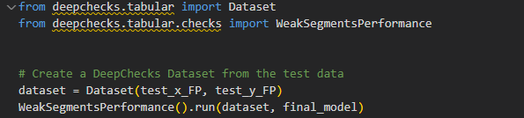
DEEPCHECKS ON FP
Filter out rows with FP outcomes
Use Deepcheck lib to analyze weak segments within FP
Check if there is a bias against any specific groups or segments with the FPs
1. The examination indicates that the misclassifications are not influenced by factors such as age and gender.
2. The weak segments contributing to false positives are related to the features
"Received Principal vs Amount,"
"Received Principal vs Work Experience,"
"Received Principal."

Slide 29
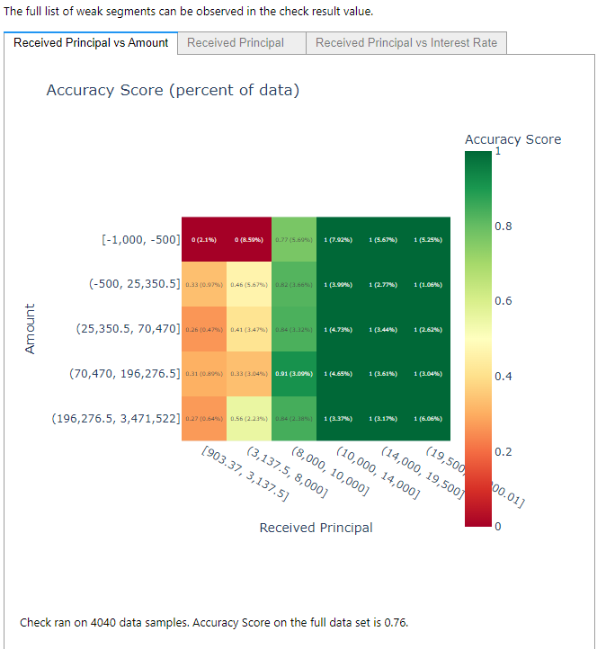
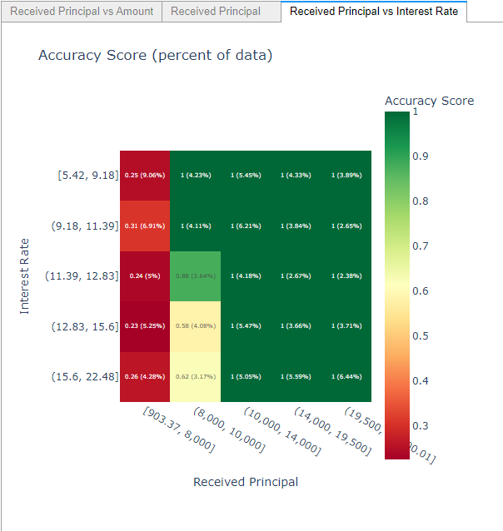
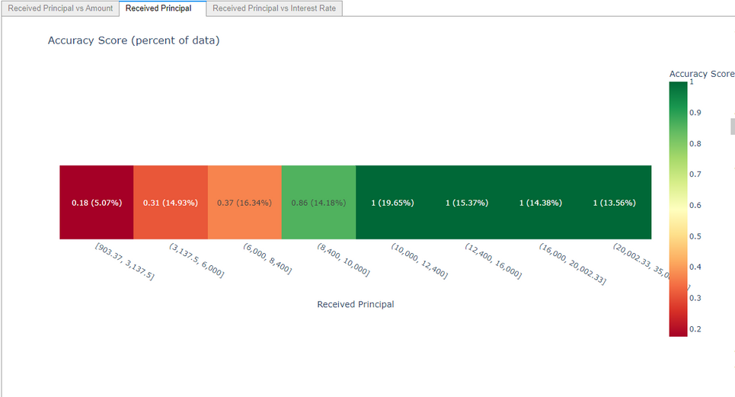
We can see that the FPs are mostly occures due to the bias the model has to “Received Principal”
It assumes that if the “Received Principal” is low regardless of the interest or the loan amount the individual is a Defaulter.
DEEPCHECKS ON FP

Slide 30
Filter out rows with FN outcomes
Use Deepcheck lib to analyze weak segments within FN
Check if there is a bias against any specific groups or segments with the FNs
DEEPCHECKS ON FN
1. The weak segments identified as
"Received Principal vs Amount,"
"Received Principal vs Work Experience,"
"Received Principal"
We can focus on building a new model specifically designed to cater to these segments.
2. We can further investigate the relationships between the received principal, amount, work experience, and other relevant features.

Slide 31
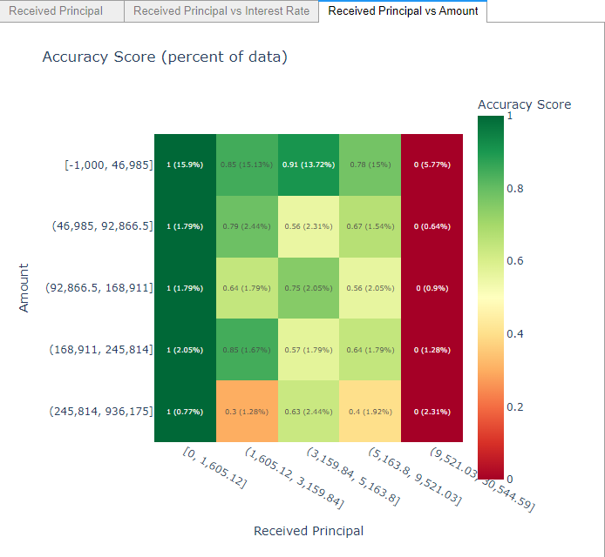
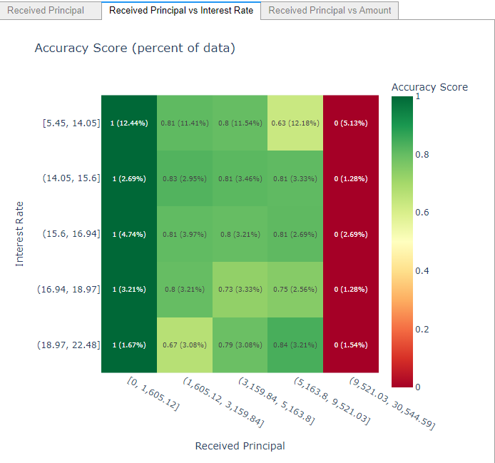
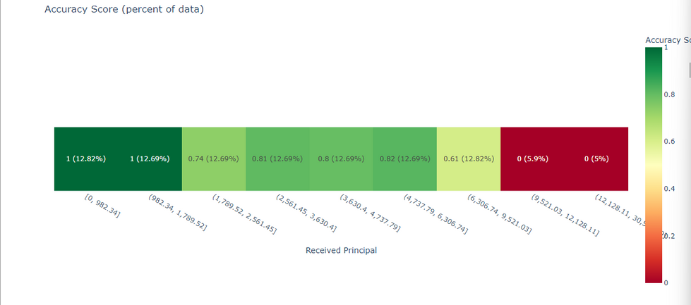
We can see that the FNs just like FPs occur due to “Received Principal”
It assumes that if the “Received Principal” is high regardless of the interest or the loan amount the individual is not a Defaulter.
DEEPCHECKS ON FN

Slide 32
SHAP VALUES
GLOBAL-LEVEL SHAP
To get an overview of which features are most important for a model we can plot the SHAP values of every feature for every sample
INSTANCE LEVEL SHAP
Local-level explanations provide data scientists with the ability to explain how different features contribute together to arrive at a specific prediction for an individual instance.

Slide 33
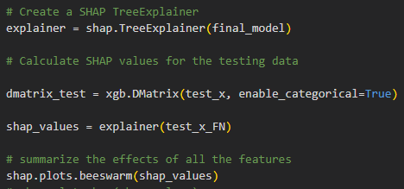
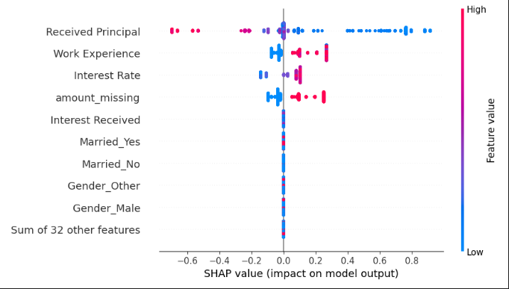
GLOBAL LEVEL SHAP
The plot below sorts features by the sum of SHAP value magnitudes over all samples, and uses SHAP values to show the distribution of the impacts each feature has on the model output.
The color represents the feature value (red high, blue low).

Slide 34
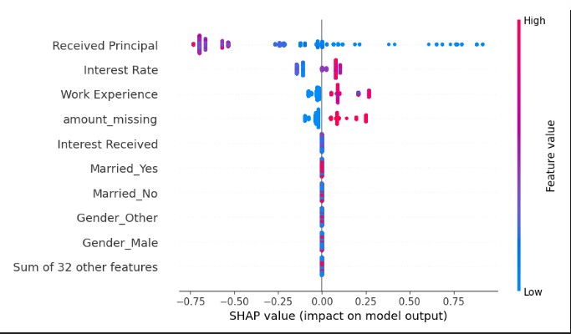
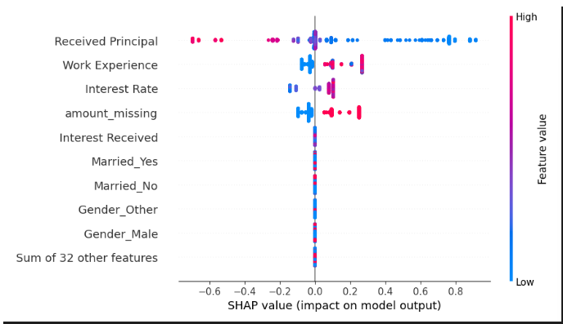

FALSE POSITIVES
FALSE NEGATIVES
A feature importance graph provides insights into the relative importance of different input variables or features in predicting the target variable (creditworthiness in this case).
High Value is denoted by red, Low value is denoted by blue
The positive SHAP values work towards increasing the predictive power of the model, negative SHAP values work vice versa.

Slide 35
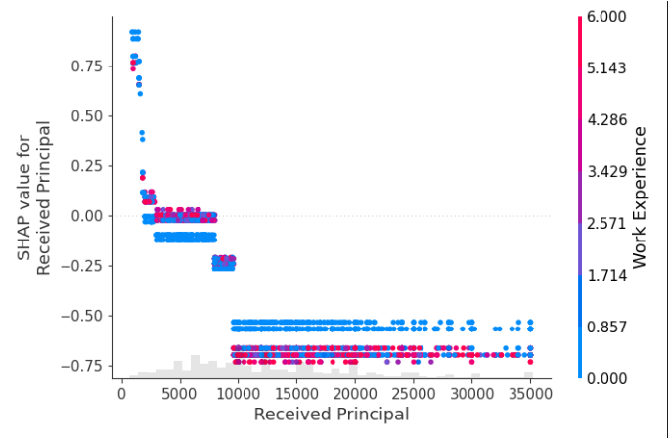
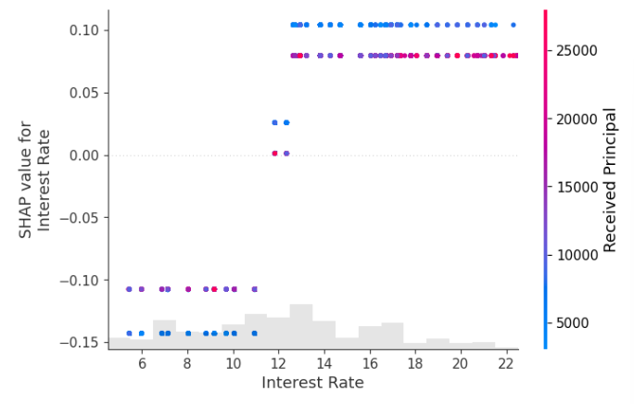
FALSE POSITIVES
FALSE NEGATIVES
Model has created assumptions that if a Received principal is low regardless of the work experience the loan is default.
i.e, Regardless of the low received principal and low work experience, there are several instances of individuals repaying back the loan.
Model has created the assumption that if a Received principal is high regardless of High Interest rate the loan is not default.
i.e, Regardless of the high received principal, there are instances of individuals not repaying back the loan amount.

Slide 36

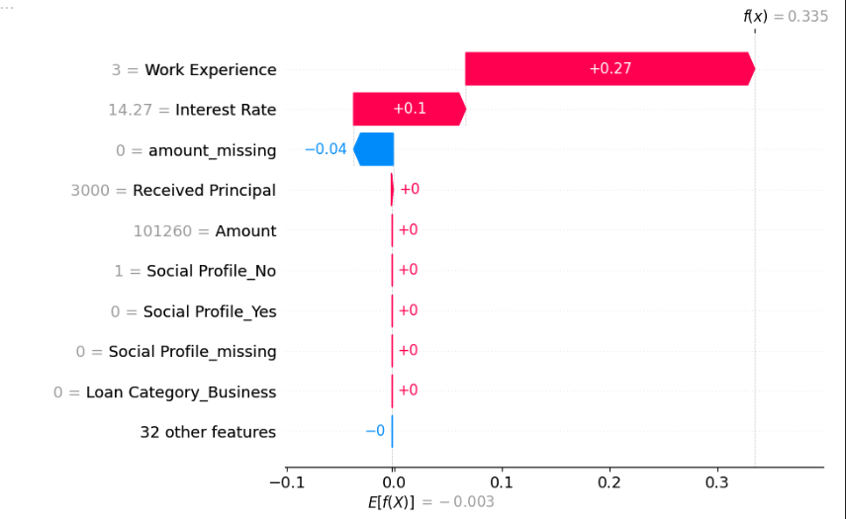
INSTANCE LEVEL SHAP
f(x) is the output of the model. For Instance 1, the model output is close to 0 and 0 stands for ‘non default’.
We can see numerically how each feature value impacted in calculating the f(x) of the model.
Here the Loan Amount was not missing, this made the model drastically decrease the chances of the output being a default prediciton.

Slide 37
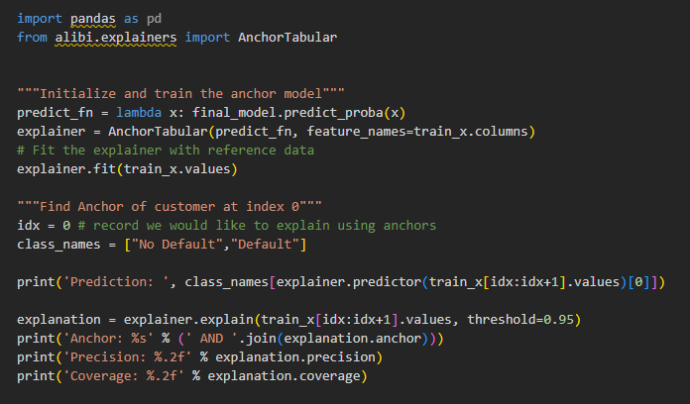

ANCHORS
Data scientists can use Anchors to provide easy-to-understand explanations for specific credit lending decisions made by the model.
Case 1: (approved for a loan). Data scientists can use Anchors to identify the most influential features that led to the approval decision and create an anchor rule
Eg., If income is greater than X dollars and credit score is greater than Y, approve the loan.
Case 2: (denied credit) Anchors can help data scientists identify the decisive factors behind the denial.
Eg., If outstanding debt is greater than $Z or employment length is less than T years, deny the loan.

Slide 38

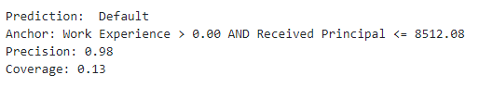
Case 1: actual = 0 and prediction=0
Addressing Fairness and Transparency Concerns of Regulators:
Regulators are often concerned with ensuring fairness, transparency, and non-discrimination in credit lending models. Anchors can assist data scientists in addressing these concerns effectively:
Case 1: They can create an anchor rule, such as "Approve the loan if race is not a discriminatory factor, income is above a certain threshold, and employment length is within an acceptable range." This rule demonstrates that the model's decisions are not influenced by race and align with fair lending regulations.
Case 2: Data scientists can use Anchors to identify any potential biases in the model's decision-making process. They can create anchor rules that explicitly state sensitive attributes (e.g., race, gender) as irrelevant for the decision.
Case 2: actual = 1 and prediction=1

Slide 39
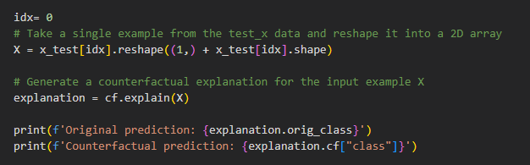

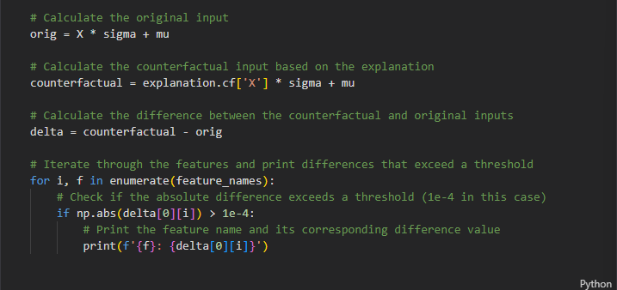
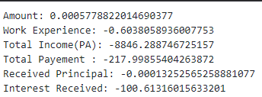
COUNTERFACTUALS
CASE 1 : LOAN DENIED
Counterfactuals gives us the smallest change in the input feature, that changes the prediction to another (predefined) output.
So in order for the loan to approved, the Total annual income should decrease by $8846. Total Payement should decrease by $218 and Interest Received should decrease by $100.

Slide 40
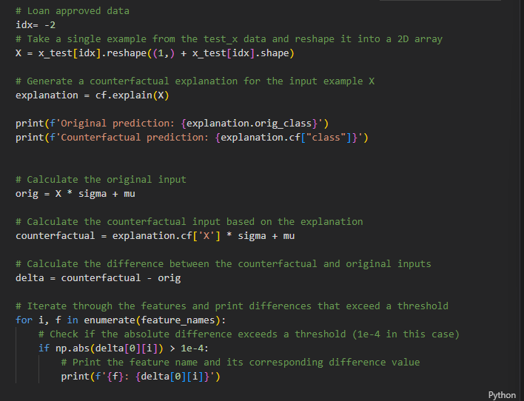
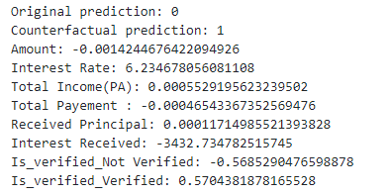
CASE 2 : LOAN APPROVED
So in order for the loan to be rejected, the interest rate should be increased by 6%, Interest received should be decreased by 3432, and is_verified should be true.
Does this counterfactual aligns with how business stakeholders think about about credit lending? Data Scientists can ask this question to business stakeholders.

Slide 41
CONCLUSION
AI transparency is crucial for industries such as financial institutions and healthcare companies.
Regulatory Compliance
XAI help meet the regulatory requiremetns by providing clear explanations for the influence to a particular decision.
Trust and Risk Assessment
By using XAI, the organization can enhance transparency and build trust with their customers, clients and patients.
Bias Detection and Mitigation
XAI lets you identify and address biases by providing insights into the model’s decision-making process.
Model Validation and Auditing
allows experts to understand how the model arrived at a decision. It helps identify potential flaws or biases in the model’s design or training data.
Error Diagnosis and Resolution
Human-AI Collaboration

Slide 42
THANK YOU
The aim of this project was to identify the application of Explainable AI in understanding the lack of predictability of the model.
provide stakeholders or decision makers insights into creating business rules.
to ensure compliance with regulatory rules and reduce large monetary loses.
ensure there are no biases or victims to the decisions made from the model.

